Slide 1
Title
Project S

Slide 2
Team
Team Members
Bryan Bolesta- Development Documentation
Matt Brodowski- Concept Developer
Ross Griebenow- Project Manager
Logan Stuart- Lead Programmer
Reed Ceniviva- Art Director
Project S

Slide 3
Problem Statement
Problem Statement
Game consumers love 2.5D sidescroller games.
Game consumers love fighting games like Super Smash Bros. Melee.
Game consumers love RPG’s.
Project S Combines all these things!
Project S

Slide 4
Scope
Project Scope
Deliver standalone executable by end of development cycle
Design all story & mechanics, implement one level
15 week (1.5 quarter) time frame
5 person team, $0 budget
Project S

Slide 5
Activities
Project Activities
Code algorithms for game mechanics
Design & implement NPC AI
Create 3D assets, textures, sound & music
Design & implement HUD & player interface
Project S

Slide 6
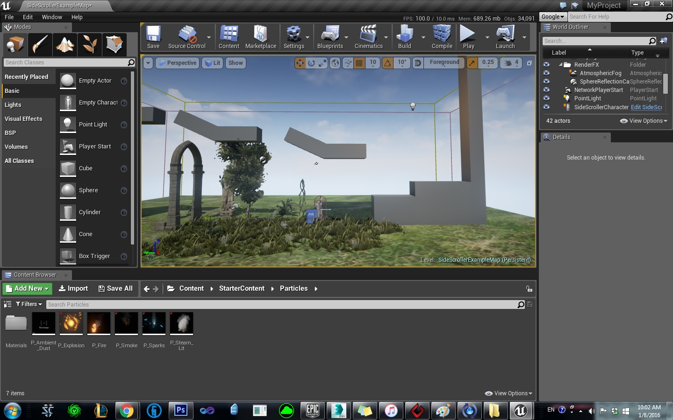
Technologies
Technologies
Unreal Engine
3DS Max
Zbrush
Visual Studio 2015
Photoshop
Project S

Slide 7
Questions
Technologies
Unreal Engine
Project S
Questions?

